Slide 1
Remote Procedure Call
Team 9
Arathy Rose Tony(2018101042)
Apoorva Thirupathi(2019121012)
Venkata Charan Chinni(20171121)
Notes:
Remote Procedure Call

Slide 2
Inter Process Communication
Shared Memory
Message Passing
Notes:
There are mainly two methods of inter-process communication: shared memory and message passing. Here we will look at a

Slide 3
What’s RPC?
Remote procedure call is a protocol that a program uses to request service from a program located in a different computer on the network without having to understand the network details.
Ideal for client server communication
Notes:
There are mainly two methods of inter-process communication: shared memory and message passing. Here we will look at a

Slide 4
Why RPC?
Client and server reside on two different machines on the same network.
RPC provides a simple method by which clients can communicate with servers by calling procedures on the server remotely.
Makes distributed programming easy by making the semantics of RPC as close as possible to conventional local procedure call.
Location transparency: The programmer need not know the actual message passing / network details.

Slide 5
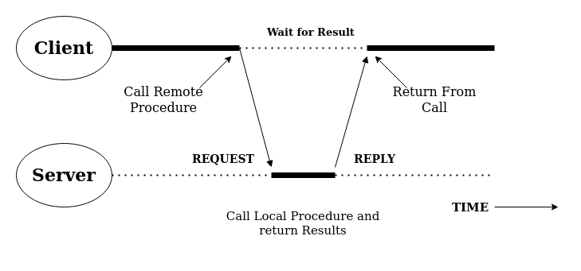
RPC Timing Diagram (classic synchronous RPC)
Notes:
RPC uses the client server model. Timing diagram for the RPC

Slide 6
What happens here?
When a process on machine A calls a procedure on machine B,
calling process on A is suspended
execution of the called procedure takes place on B.
Once the execution is done on the server, the results of the process execution is sent back to the client.
Information can be transported
From the caller to the callee in the parameters
From callee to caller in the procedure result.

Slide 7
RPC Elements
Client: initiates the call
Client stub: marshals the parameters
RPC Runtime: handles message transmission
Server Stub: un-marshals the parameters
Server: executes the remote procedure
Notes:
Client: initiate RPC by making a call to a procedure on a different server
Client stub: packs request message from client and asks RPC runtime to send; also unpacks the response from the server
RPC Runtime: handles message transmission between client and server
Server stub: unpacks the call request from the client and sends it to the server; also packs the response from the server before sending it via the RPC runtime
Server: executes the local procedure and sends the result and

Slide 8
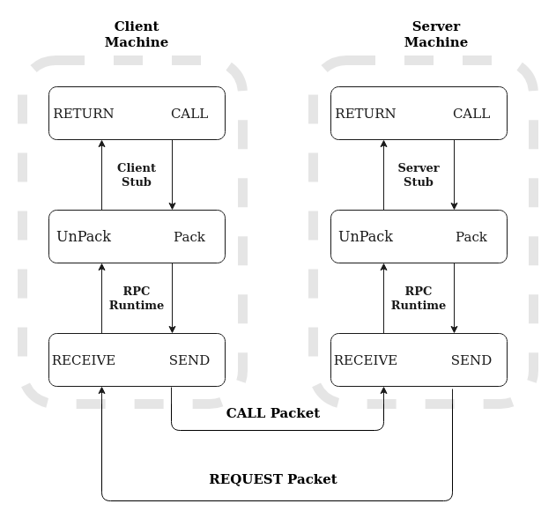
Work-Flow

Slide 9
Steps of the workflow-1
The client initiates the RPC by making the call to the remote procedure.
The client stub packs the parameters into a message packet. This process is called marshalling.
The client stub asks the RPC runtime to send the message via the network to the server stub.
RPC Runtime handles message transmission between client and server
The server stub receives the call packet and unpacks the arguments and sends it to the server. This process of unpacking is called unmarshalling.
The server executes the remote procedure.

Slide 10
Steps of the workflow-2
The server sends the result to the server stub.
The server stub packs the results from the server.
The server stub sends the result packet via the runtime back to the client stub
The client stub unpacks the results and sends it to the client.

Slide 11
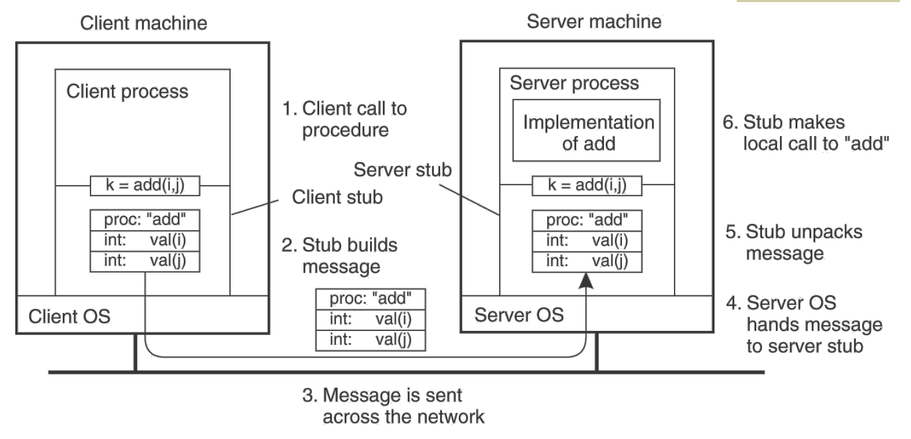
Pass by Value Example

Slide 12
RPC Advantages
Simple call syntax similar to local procedure calls
Makes distributed programming easy
Location transparency
Well defined interface

Slide 13
RPC Design Issues
Memory access: RPC does not support pass by reference
Low speed / Latency
Vulnerable to failure / partial failure

Slide 14
Issue 1: Pass by value
different address space
references and addresses of one system are meaningless in the other system.

Slide 15
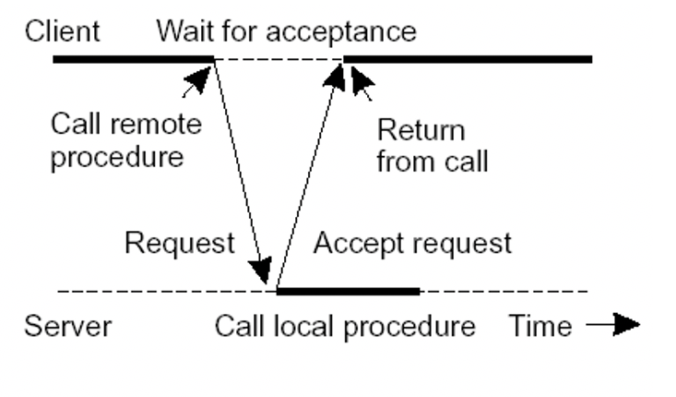
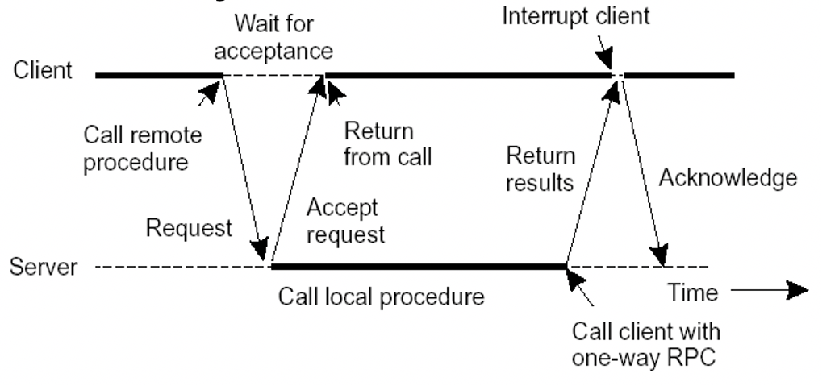
Issue 2: High Latency
low speeds compared to a local procedure call
calling program must wait for the execution of the remote process to complete.
Can be fixed by using asynchronous RPCs
Asynchronous RPC
Deferred Synchronous RPC

Slide 16
Issue 3: Short messages
RPC messages are generally quite short, and
overhead involved with connections may be undesirable.
connectionless/unreliable communication protocol is often preferred.
LAN is mostly used here.

Slide 17
Issue 4: Vulnerable to failures
Since RPC involves communication with a different system, the chance of errors is quite high. There are 4 main ways where the RPC can fail:
The message packet from the client to the server goes missing
The result packet from the server to the client goes missing
The client crashes after sending the request
The server crashes after receiving the request
Hence, we need to find ways of handling such types of failures.

Slide 18
How to fix issue 4?
One way to handle such errors is exit the entire call when there is a partial failure, but this isn't correct. Hence, we need to break the transparency and show the programmer where exactly the program failed.
Possible semantics for RPC by which this issue can be resolved are on the next slide.

Slide 19
How to fix issue 4? (contd.)
Possible semantics for RPC by which this issue can be resolved:
Exactly-once (what local procedure calls provide): Impossible in practice
At least once: Only for idempotent operations
At most once: Zero, don’t know, or once
Zero or once: Transactional semantics (databases!)

Slide 20

Questions

